Slide 1
Web Scraping
Presented By:
Nitesh Namdev

Slide 2
Abstract
Web scraping, also known as data Mining, is the process of collecting large amounts of data from the web and then placing it in database for future analysis and later use.
It offers insight into price data, market dynamics, prevailing trends, practises employed by competitors and the challenges they face.
In this article, We will explain the advantages of Web scraping technique.
This research is based on web based python scrapping tool and the main focus is on BeautifulSoup to scrap the data.

Slide 3
Introduction
The internet is a bottomless well of knowledge that is open to everyone. Because of the latest technological developments, we had to rethink our company practices.
Data crawling, online scraping, and data harvesting have been around for as long as the internet itself has been around. However, at the beginning , it wasn’t always used for web content extraction.
It is possible to think of online scraping as the process of obtaining or extracting content from a website. In web scraping, content is taken from a online sources and used in a manner.

Slide 4
What is web scraping?
Web scraping (Web harvesting) is a software technique of extracting information from websites.
While web scraping done manually by a software user, the term typically refers to automated processes implemented using a bot or web crawler.
It focuses on transformation of unstructured data on the web (Typically HTML), into structured data that can be stored and analyzed.
It is a form of copying in which specific data is gathered and copied from the web, typically into a central local databases or spreadsheet, for later retravel or analysis.

Slide 5
Why we scrape?
Web pages contain wealth of information (in text form), designed mostly for human consumption.
Static websites (legacy systems)
Interfacing with 3rd party with no API access
Websites are more important than API’s
The data is already available (in the form of web pages)
No rate limiting
Anonymous access

Slide 6
Fetching the data
Involves finding the endpoint – URL or URL’s
Sending HTTP requests to the server
Using requests library:
import requests
data = requests.get(‘http://python.org.com/’)
html = data.content

Slide 7
Use BeautifulSoup for parsing
Python library for pulling data from HTML and XML files.
Provides simple methods to-
* search
* navigate
* select
Deals with broken web-pages really well
Auto-detects encoding
You may use this tool to not only scrape data, but also to clean it up.
A number of python parsers, including lxml and hml5lib, are supported by BeautifulSoup , in addition to the HTML parser included in Python’s standard library.

Slide 8
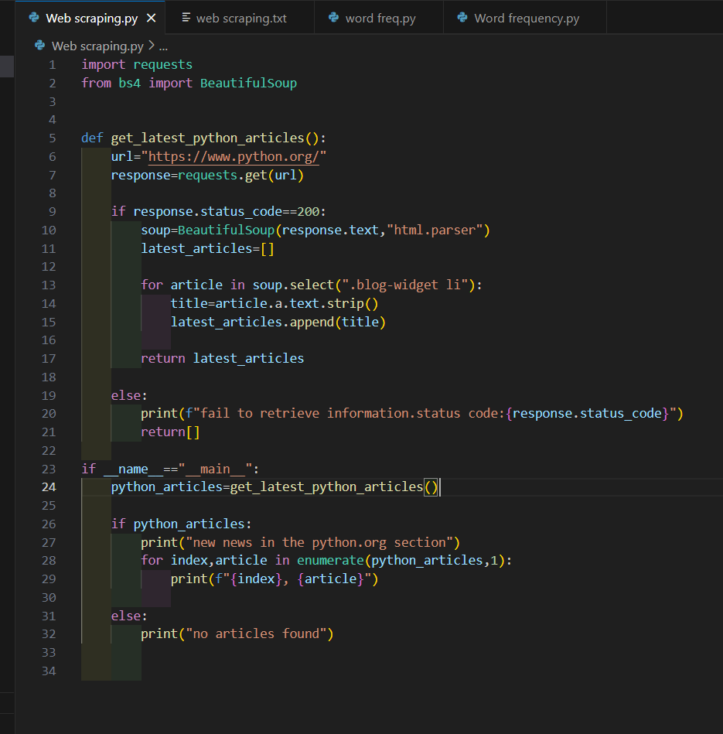
Live demo

Slide 9
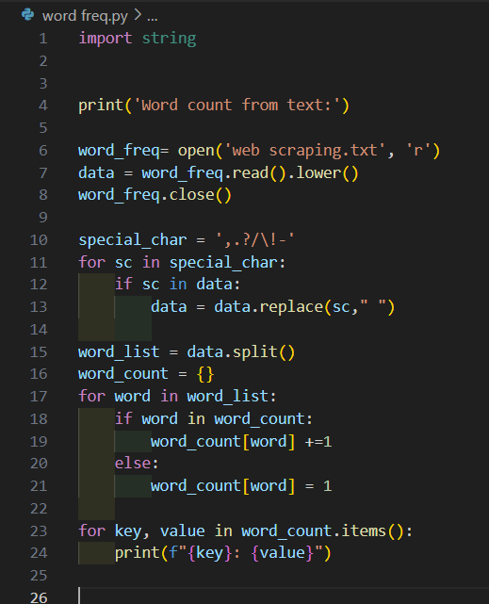
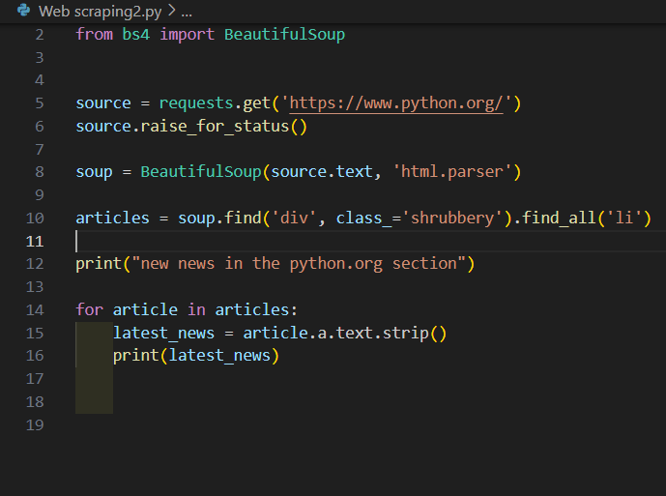
Live demo

Slide 10
Conclusion
As a result of the Internet’s availability, information-seeking activities grew common and time-consuming, making them among of the most prevalent and time-consuming activities. For the first time, we will be able to acquire large amounts of data without putting in a lot of effort or money. With web scraping, business may gain insight into their target market and make better decisions, whether they are in e-commerce or e-marketing.

